Slide 1

Clearing the Fog! Getting Started on Cumulus:
a Near to the Ground On Campus Cloud Solution

Slide 2
Getting Started on CUmulus
Gerardo Hidalgo-Cuellar (RC User Support)
Chris Horen (RC Cloud Engineer)
www.rc.colorado.edu
rc-help@colorado.edu
Slides and tutorial: https://github.com/ResearchComputing/CUmulus_tutorials
Survey at: http://tinyurl.com/curc-survey18

Slide 3
Learning Objectives
Logging into CUmulus with Horizon (the CUmulus web portal)
Creating your instance (i.e. virtual machine)
Logging into your instance via ssh

Slide 4
Outline
CURC Overview
What is CUmulus?
CUmulus Access
Access to CUmulus and the allocation process
Logging into Horizon (CUmulus web portal)
Creation of an instance
Logging into your instance
Demo workflow one might use on CUmulus:
Web App & Database

Slide 5
CU Research Computing Overview
Provides Computing and Data Beyond the Desktop resources:
High Performance Computing (HCP), clusters include:
Alpine (beta)
Summit
Blanca
Storage of Research Data
PetaLibrary
High-Speed Data Transfer
Globus Endpoint
Consulting in Computational Science and Data Management
Cloud Resources
CUmulus

Slide 6
What is CUmulus?
CUmulus is CU Research Computing's free-to-use on-premise cloud service
Supports cases not well-suited for HPC such as:
Research-Oriented Web Servers
Databases
Long-Running Services
Provides users with persistent or ongoing availability by allocating logically isolated section of the cloud

Slide 7
What is CUmulus?
You get your own virtual “world” for experimentation - an environment that can be easily created/tested/removed
Install Software
Administer your instance (you’re in control!)
Run applications and jobs
Interface w/ other CURC services: Blanca, Alpine, PetaLibrary
You can request specific resources (CPU, storage, memory) and can set up persistent storage

Slide 8
CUmulus Access

Slide 9
CUmulus Access and Allocation
Submit a proposal for your use case (email rc-help@colorado.edu)
Describe your CUmulus workflow
Describe why your workflow is appropriate for CUmulus
Estimate the resources you require:
Operating System, CPU cores, Disk Space, Memory
This is an iterative process where we work with you to make sure the request for resources fits your (and our) needs
Learn more about the allocation request process at https://www.colorado.edu/rc/userservices/allocations

Slide 10
Log in to Horizon
There are 3 current authentication/login methods at cumulus.rc.colorado.edu/:
CU Boulder
CSU Fort Collins
XSEDE* (all other RMACC institutions)
Create account: https://portal.xsede.org/#/guest
Configure 2FA (Duo): https://portal.xsede.org/mfa
*Don’t need an RC account with XSEDE for this class, but will make things easier

Slide 11
RC account check
Who does not have a CU Research Computing account who would like to use a temporary account*?
If you don’t have access to the CU VPN or don’t have an RC account, you will need a temp account to connect to a VM
*only available during session

Slide 12
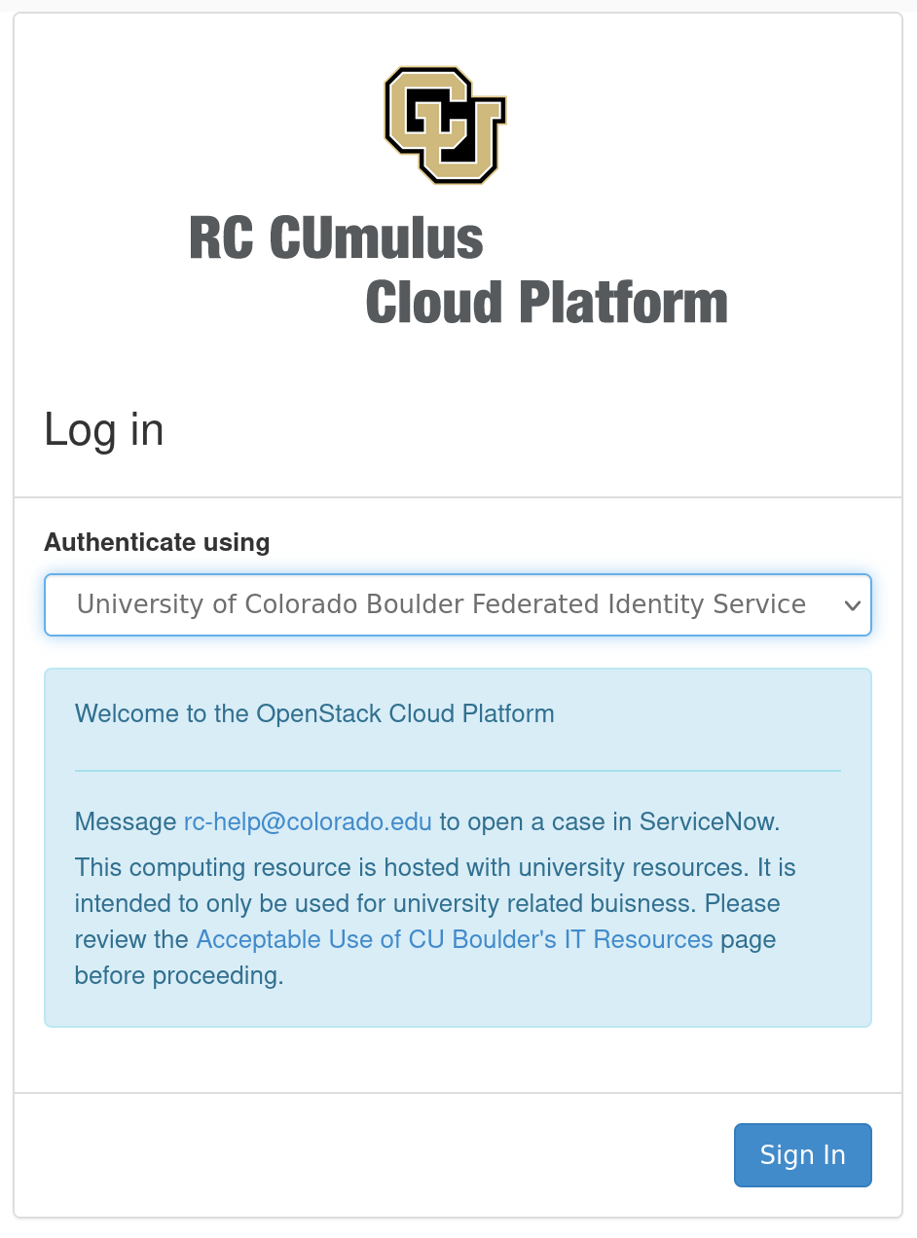
Log in to Horizon
Horizon is the CUmulus web portal
cumulus.rc.colorado.edu/
Let’s take a brief tour of Horizon
Log in with your institution’s credentials:

Slide 13
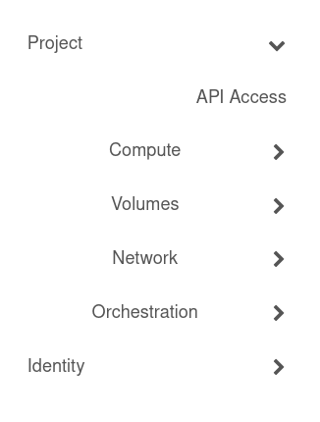
Navigate Horizon
Choose your project (top left)
Generally users only have 1 project
4 main sections
Compute
Volumes
Networks
Orchestration

Slide 14
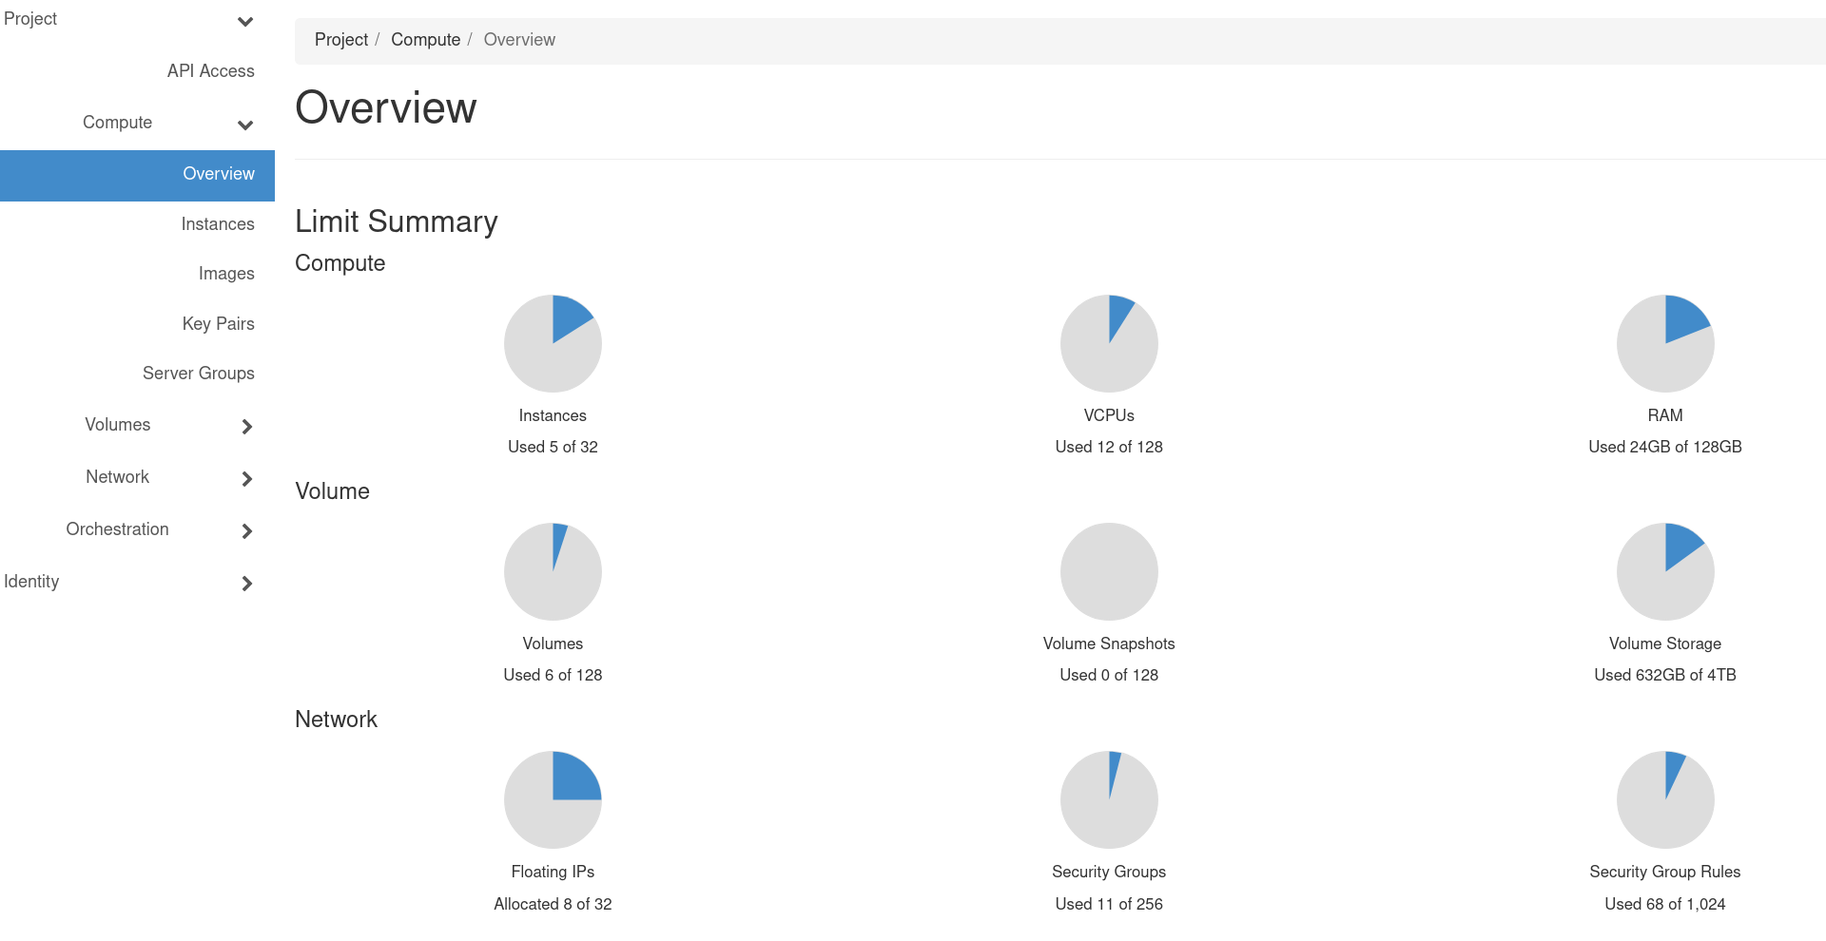
Navigate Horizon: Overview
Land on the Overview page under “Compute”
quick summary of your project

Slide 15
Navigate Horizon: Instances
Navigate to:
Project->Compute->Instances
Instances are virtual machines that run inside the cloud, more simply: an instance is just a digital version of a physical computer
Instances can perform almost all of the same functions as a computer, including running applications and operating systems

Slide 16
Instance Creation

Slide 17
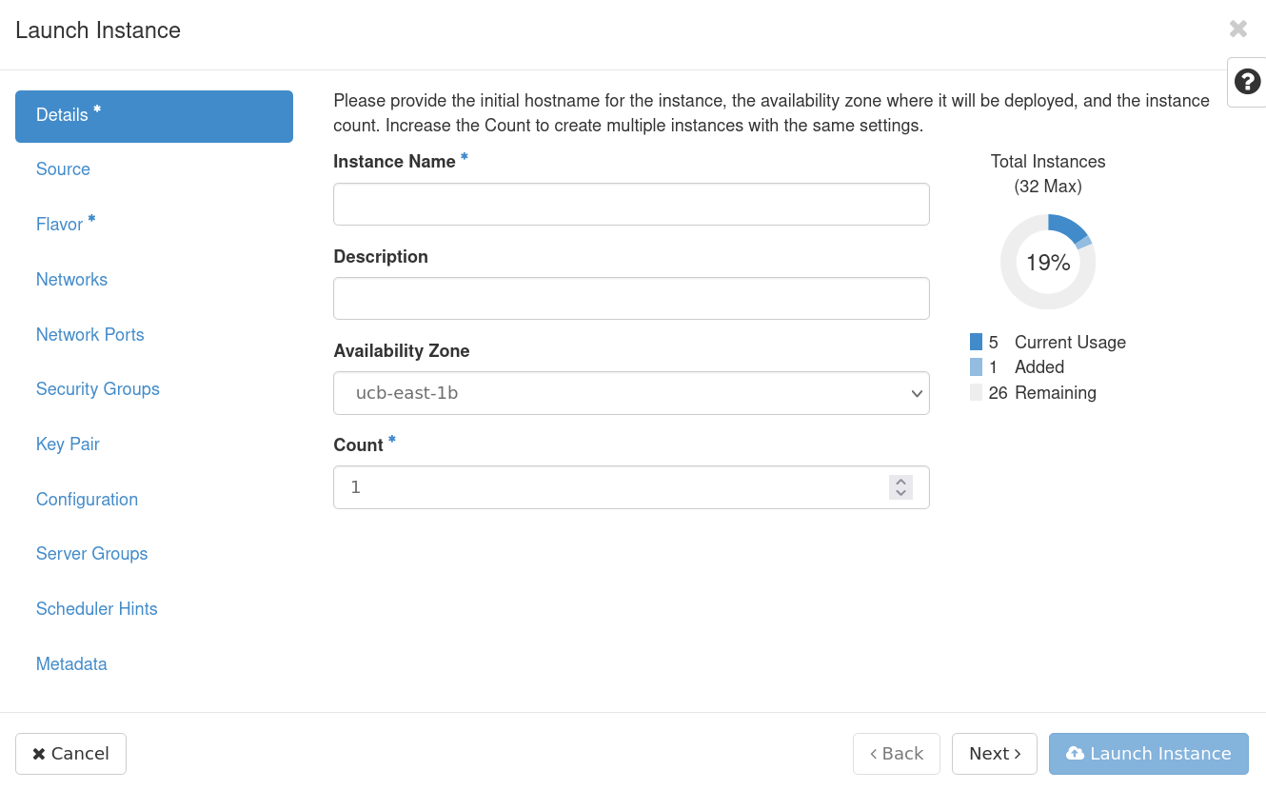
Let’s create a simple instance together
From the instances page click on “Launch Instance”
The Instance Creation Launcher will pop up giving us options to create our virtual machine

Slide 18
Details
Fill out Instance details, including a name and description
availability zone and count can be left as defaults

Slide 19
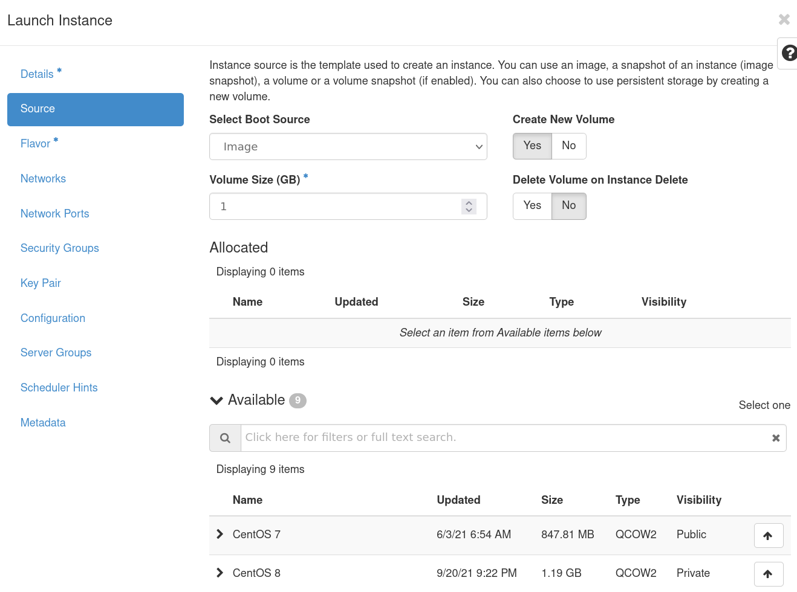
Source
Choose an image from the available list
A virtual machine image (“image”) is a single file that contains a virtual disk that contains a bootable operating system
Choose to have your storage volume deleted on instance deletion
If you select “no” be aware of “zombie” volumes

Slide 20
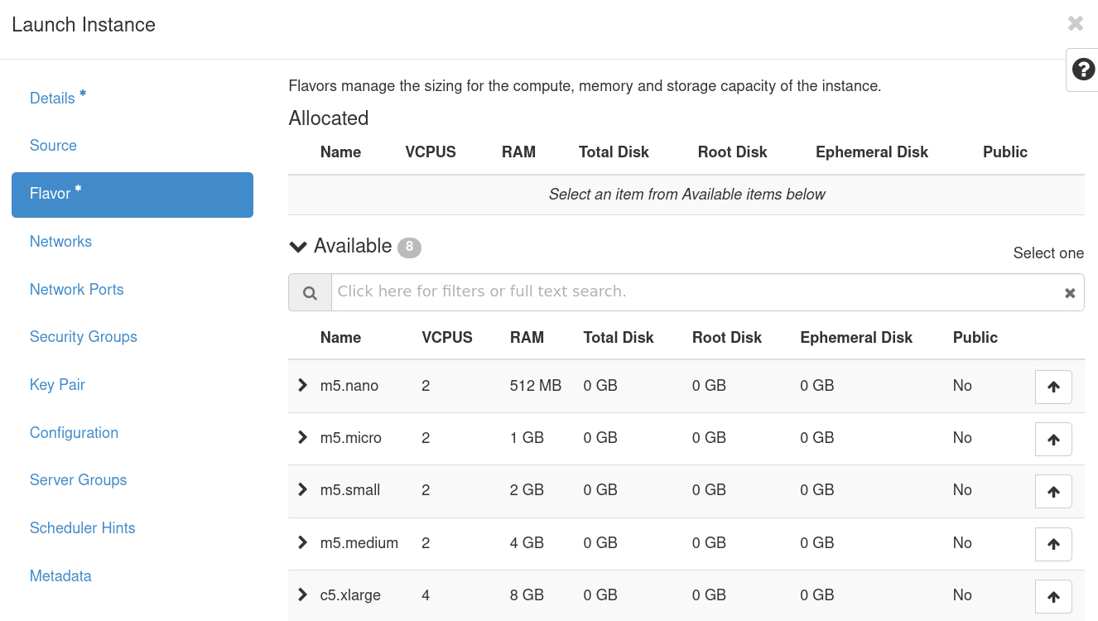
Flavor
Choose from a list of pre-selected resources:
A flavor defines the compute, memory, and storage capacity of our instance.

Slide 21
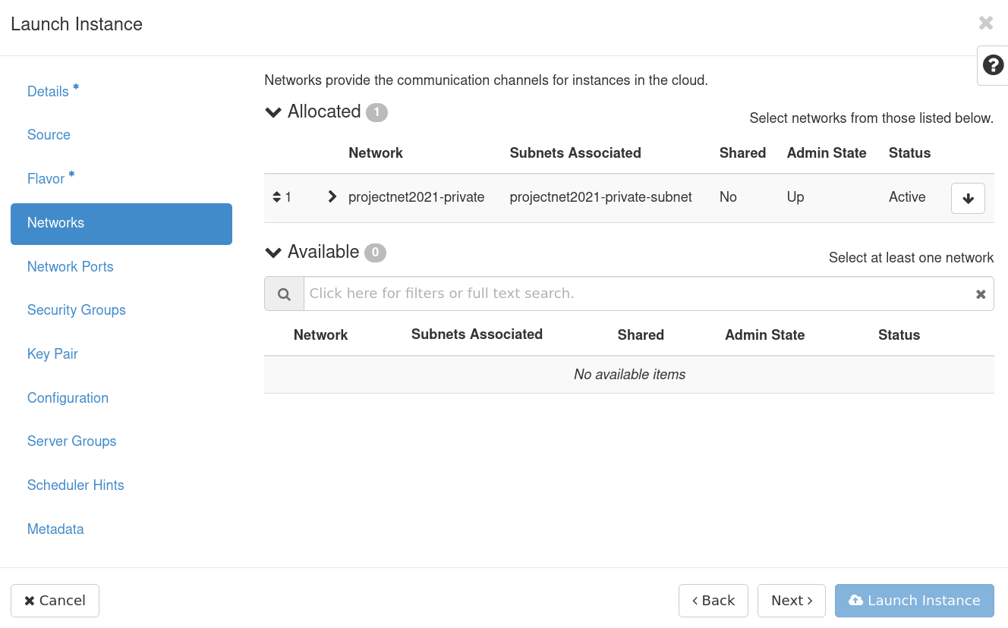
Networks & Network Ports
Select a project network, which determines routability of either a public/internet or campus/internal floating IP.
We’ll choose an external network: projectnet26140-private
Ports provide extra communication channels to your instances
You can select ports instead of networks or a mix of both

Slide 22
Networks: An aside
Two network types are provided:
172.18.XX.XX - restricts your instance to CU internal network
172.26.XX.XX - allows certain ingress/egress from the public internet (for certain access, e.g http, https)
Direct shell access (e.g. ssh, powershell) is restricted to the CU internal network due to multi-factor-authentication requirements
This means that you will need to be on the CU network to access your instance (either VPN or through RC).

Slide 23
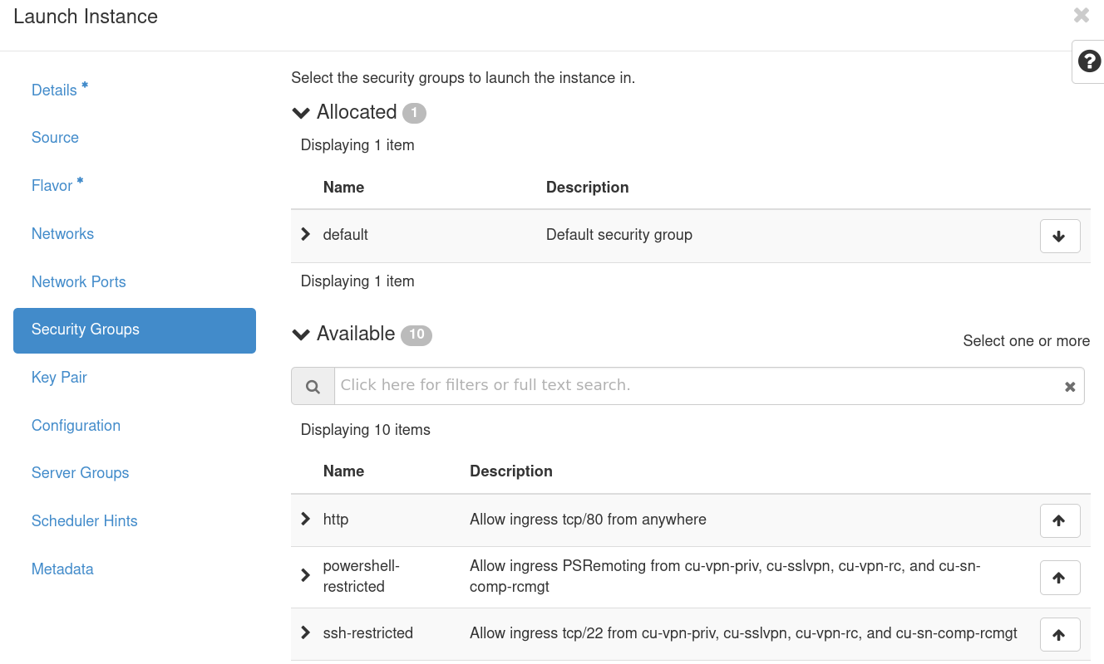
Security Groups
Security Groups act as a virtual firewall for your instance to control inbound and outbound traffic.
We’ll choose ssh-curc, ssh-restricted, http, and https for our demo

Slide 24
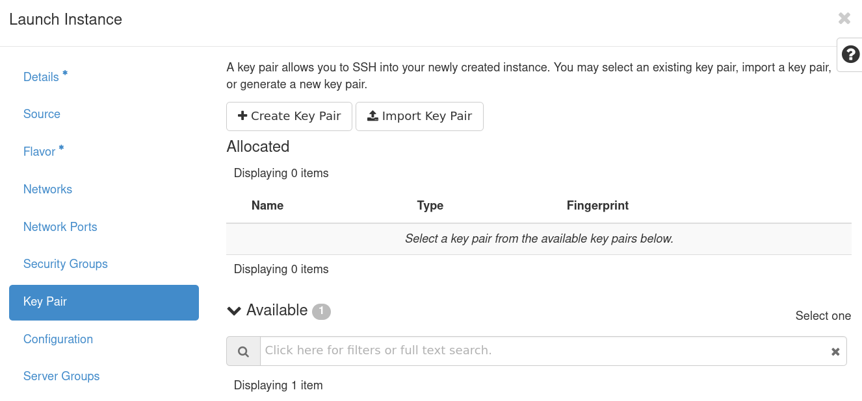
Key Pairs
A key pair allows you to SSH into your new instance
You may select an existing key pair, import a key pair, or generate a new key pair
I find it easiest to create a keypair on my machine and import it
https://www.ssh.com/academy/ssh/public-key-authentication

Slide 25
Key Pairs: An aside
You will need to create an SSH key from or copy it to a computer you have CU internal access to:
If you have an RC account already, login as follows from a terminal:
If you don’t have an RC account, log into a temporary account from a terminal:
$ ssh <username>@login.rc.colorado.edu
# Where <username> is your identikey
$ ssh user<XXXX>@tlogin1.rc.colorado.edu
# Where user<XXXX> is your temporary username, RC will provide pw

Slide 26
Key Pairs: An aside
SSH keys are an access credential that is used in the SSH protocol
They can be tricky to set up however, so we'll go over a simple example here. From your terminal in a local machine use the ssh-keygen command to create a new ssh keypair:
Our new keypairs have been created at /home/username/.ssh/ and are called id_ed25519 and id_ed25519.pub. The public key (.pub) can be transferred to other remote servers (this is the key we will import to our CUmulus instance) but the private key (no suffix) should never leave the host machine.
$ ssh-keygen -t ed25519
Generating public/private ed25519 key pair.
Enter file in which to save the key (/home/username/.ssh/id_ed25519):

Slide 27
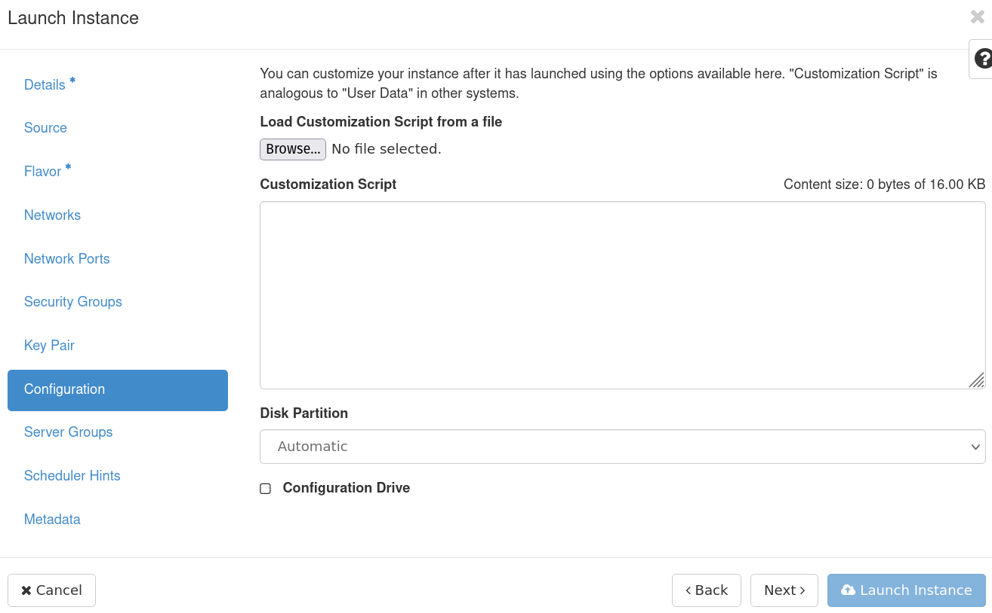
Config, Server Group, Scheduler Hints, and Metadata
We’ll leave these as defaults as they are extra configuration we can provide our instances, but not necessary

Slide 28
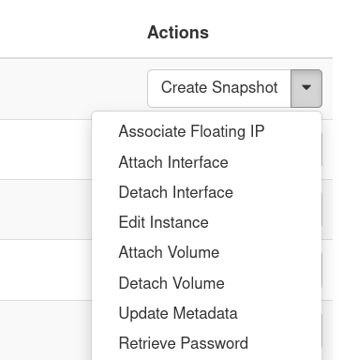
Launch Instance and Associate IP
Launch instance and wait for it to be set up
In the meantime we can associate a Floating IP which will allow us to access the instance from outside of the CU network
On the right hand side of the newly created instance choose “Associate Floating IP” under the “actions” dropdown

Slide 29
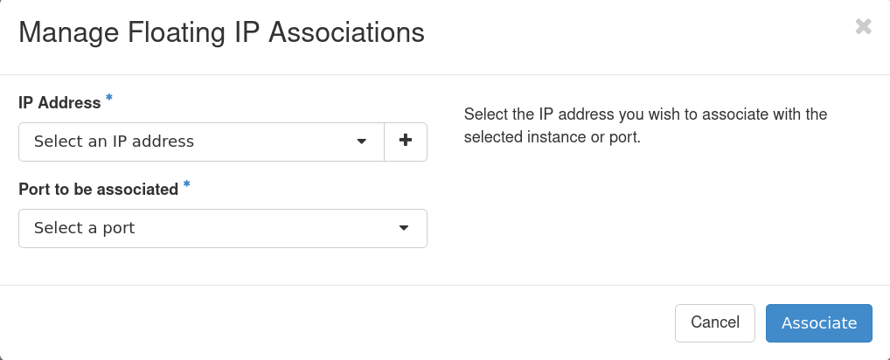
Associate IP
Select from available IP addresses
If needed you can add a floating IP
Select port to be associated
This should be pre-populated with the internal IP of your new instance

Slide 30
Logging into your Instance

Slide 31
Logging In
You must be on the CU internal to connect via ssh (CURC restriction)
Open up an ssh connection providing the identity (key) file:
For an ubuntu instance this will look something like:
$ ssh -i ~/.ssh/<private key> <hostname>@<external floating IP>
$ ssh -i ~/.ssh/testkey ubuntu@123.456.789.123

Slide 32
Logged In
Congratulations! You are now logged into your instance
You can now:
Install Software
Administer your instance
Run applications and jobs

Slide 33
Demo

Slide 34
Demo workflow: Twitter API with DB
There are a (nearly) infinite number of workflows you could run on your CUmulus instance*
*As long as the workflow is related to research, personal projects are not permitted
We’ll demo a potential workflow: a web application which allows users to query using the Twitter API and store this data persistently to a mysql database
This demo showcases a few important features of CUmulus not possible on HPC:
A persistent workflow not limited by wall clock times
User administration of compute resources (using root privileges for applications such as Docker)
Routable floating IPs available on the Public Internet

Slide 35
Demos:
Setting up an Instance
Twitter API with Database
CUmulus integration with CURC HPC
Mounting a remote filesystem from a CUmulus Virtual Machine
Users that are not using tutorial accounts may access CUmulus and your instances for the next week to test and run through tutorials

Slide 36
Thank you!
Survey: http://tinyurl.com/curc-survey18
Help Desk: rc-help@Colorado.edu

